Slide 1
Decision tree regressor (id3)

Slide 2
Decision tree
Decision tree builds prediction or classification models in the form of a tree structure. It breaks down a dataset into smaller and smaller subsets while at the same time an associated decision tree is incrementally developed. The final result is a tree with decision nodes and leaf nodes.
The topmost decision node in a tree which corresponds to the best predictor called root node. Decision trees can handle both categorical and numerical data.
Decision tree regression observes features of an object and trains a model in the structure of a tree to predict data in the future to produce meaningful continuous output.
observes features of an object and trains a

Slide 3
ID3
Given by Ross Quinlan
The Iterative Dichotomiser 3 algorithm iteratively divides the features to two or more groups at each step.
Uses a top-down, greedy approach.
Mostly used for classification problem with nominal features.

Slide 4
Why Standard deviation and standard deviation reduction?
A decision tree is built top-down from a root node and involves partitioning the data into subsets that contain instances with similar values (homogenous). We use standard deviation to calculate the homogeneity of a numerical sample. If the numerical sample is completely homogeneous its standard deviation is zero.
The standard deviation reduction is based on the decrease in standard deviation after a dataset is split on an attribute. Constructing a decision tree is all about finding attribute that returns the highest standard deviation reduction (i.e., the most homogeneous branches).

Slide 5
Algorithm framework
• Start from the root node with all data
• For each node, calculate the SDR of all possible features
• Choose the feature with the highest SDR
• Split the data of the node according to the feature
• Do the above recursively for each leaf node, until the termination conditions are met.

Slide 6
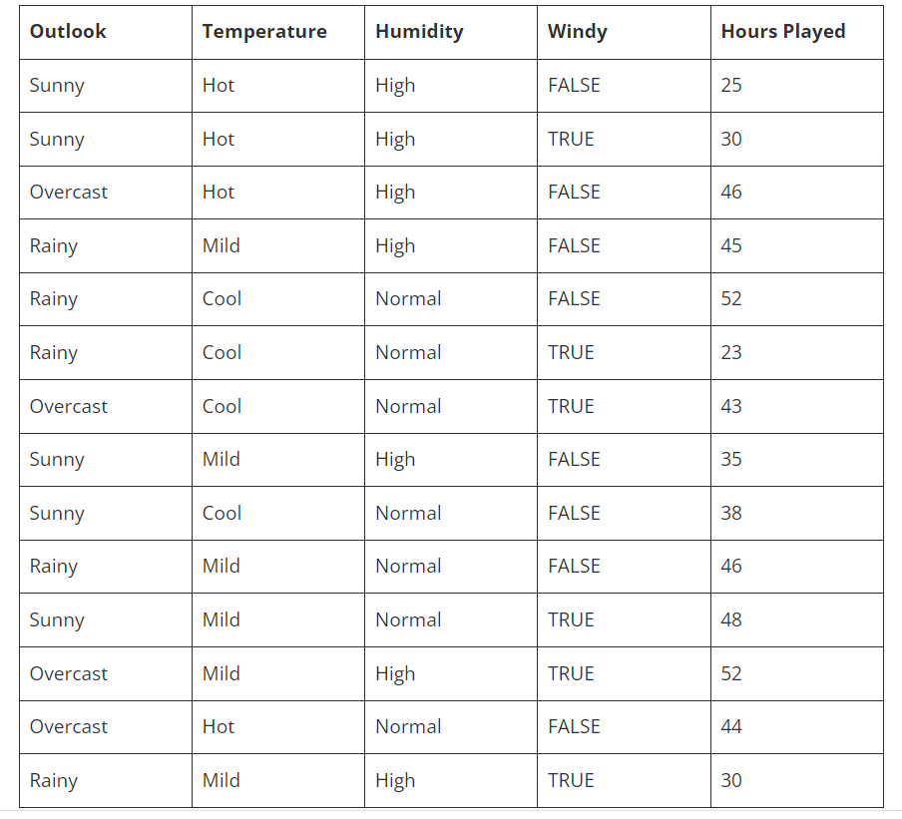

Slide 7
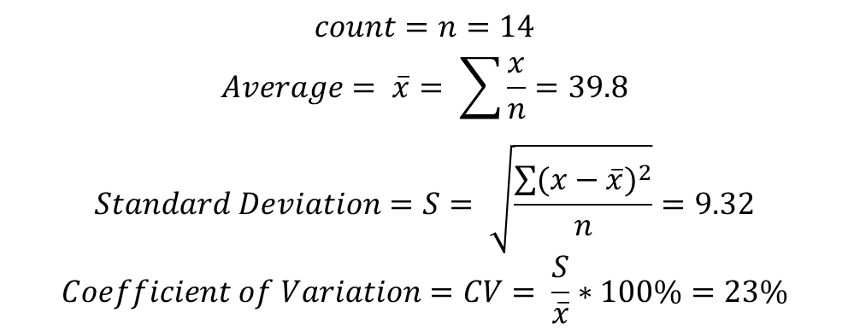
Step 1: First will calculate the total standard deviation with respect to target variable:
Hours Played
26
30
48
46
62
23
43
36
38
48
48
62
44
30
$$count=n=14$$
$$Average= \overline{x}= \sum{\frac{x}{n}}=39.8$$
$$Standard Deviation=S= \sqrt{\frac{\sum{{(x−\overline{x})}^{2}}}{n}}=9.32$$
$$Coefficient of Variation=CV= \frac{S}{\overline{x}}∗100\%=23\%$$

Slide 8
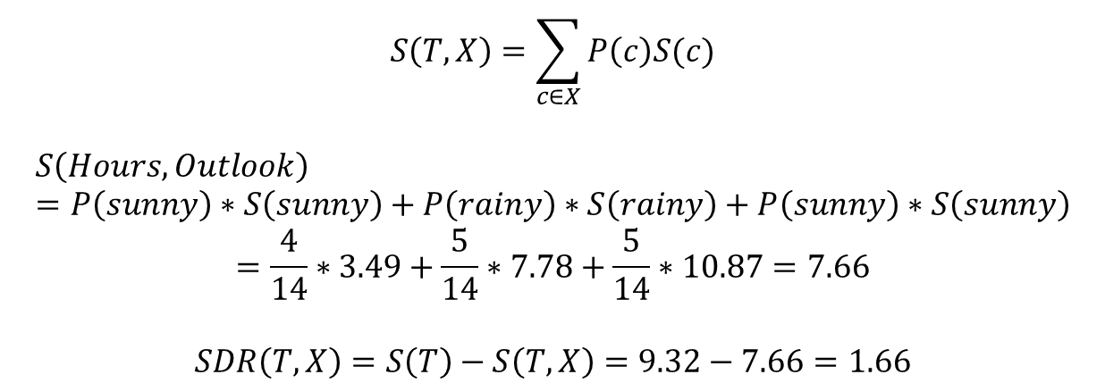
Step 2: will calculate SDR with respect to independent variables and decide on root node, decision nodes and leaf nodes.
Outlook | Hours played
Rainy | 26
Rainy | 30
Overcast | 48
Sunny | 46
Sunny | 62
Sunny | 23
Overcast | 43
Rainy | 36
Rainy | 38
Sunny | 48
Rainy | 48
Overcast | 62
Overcast | 44
Sunny | 30
 |  | SD (Hours played) | Count
Outlook | Overcast | 3.49 | 4
 | Rainy | 7.78 | 5
 | Sunny | 10.87 | 5
 |  |  | 14
$$S\left(T,X\right)=\sum_{c∈X}{P\left(c\right)S(c)}$$
$$S\left(Hours,Outlook\right)=P\left(sunny\right)∗S\left(sunny\right)+P\left(rainy\right)∗S\left(rainy\right)+P\left(sunny\right)∗S\left(sunny\right)$$
$$=\frac{4}{14}∗3.49+\frac{5}{14}∗7.78+\frac{5}{14}∗10.87=7.66$$
$$SDR\left(T,X\right)=S\left(T\right)−S\left(T,X\right)=9.32−7.66=1.66$$

Slide 9
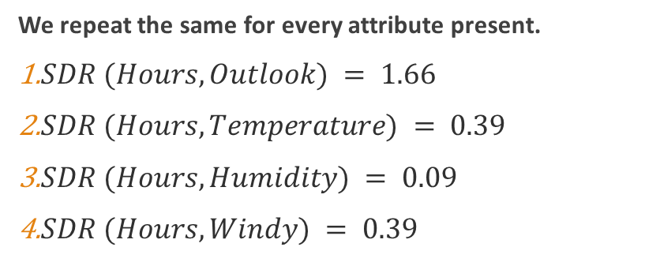
We repeat the same for every attribute present.
$SDR (Hours, Outlook) = 1.66$
$SDR (Hours, Temperature) = 0.39$
$SDR (Hours, Humidity) = 0.09$
$SDR (Hours, Windy) = 0.39$

Slide 10
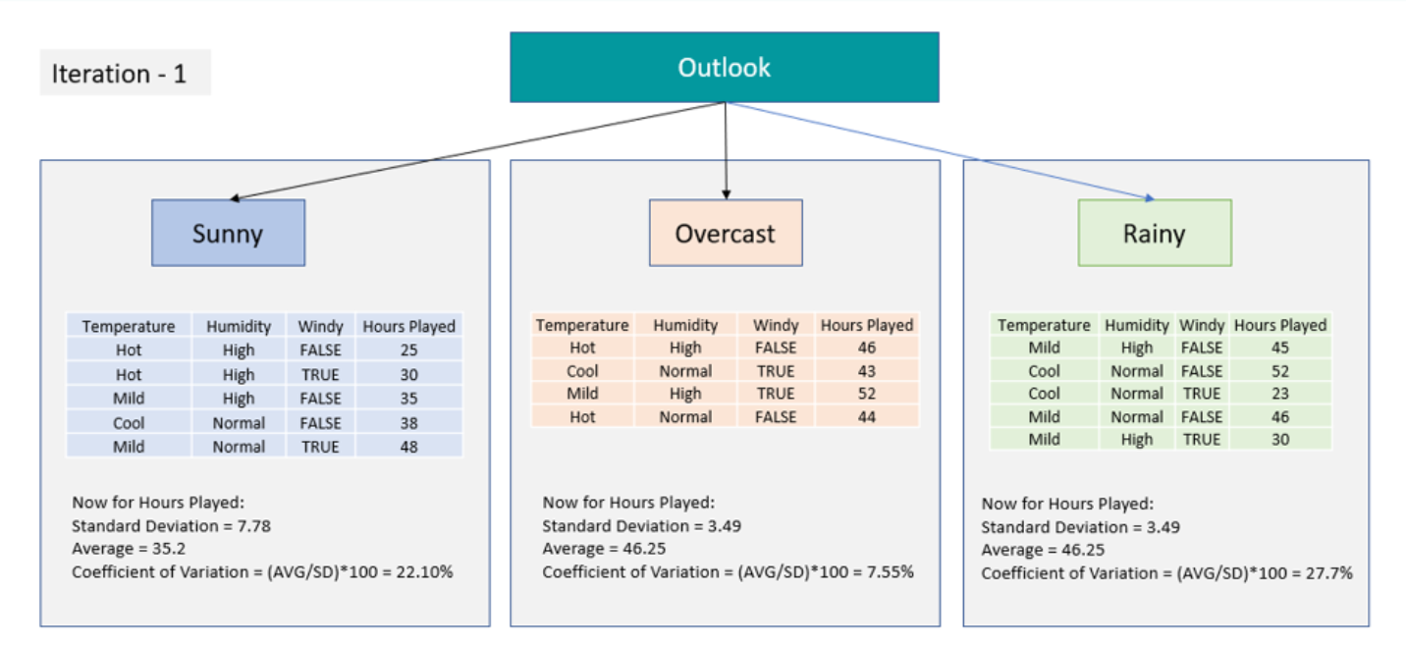
Step 3:The attribute with maximum SDR is chosen as the root node.

Slide 11
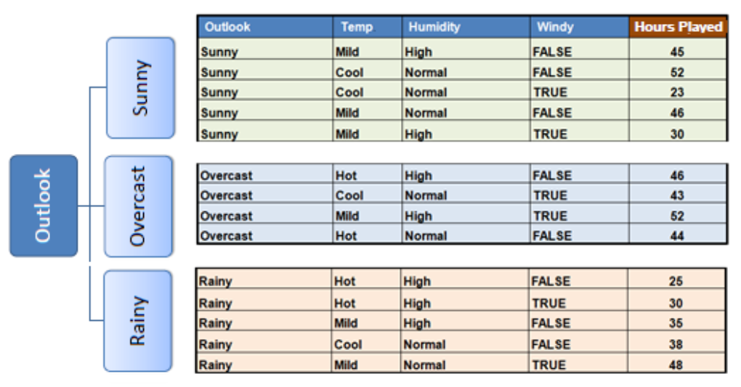
Step 4.a: The dataset is divided based on the values of the selected attribute. This process is run recursively on the non-leaf branches, until all data is processed.

Slide 12
Step 4.b: Check for termination criterions.
Termination criteria:
We need some termination criteria like when to stop splitting. Hence, we consider coefficient of variance as one of the termination criteria and for example can set CV = 10% as a threshold. So, if we have CV > 10% then further splitting is required else will stop there. Or we can also set threshold on number of data points (rows) if less than or equal to 3 then no split required.
And the prediction at leaf node will be the average of that branch.
Here Sunny and Rainy nodes need further splitting as both have CV > 10% however Overcast does not need splitting as CV for overcast <= 10%.
Average value of overcast branch = 46.25 will be the prediction at overcast leaf.

Slide 13
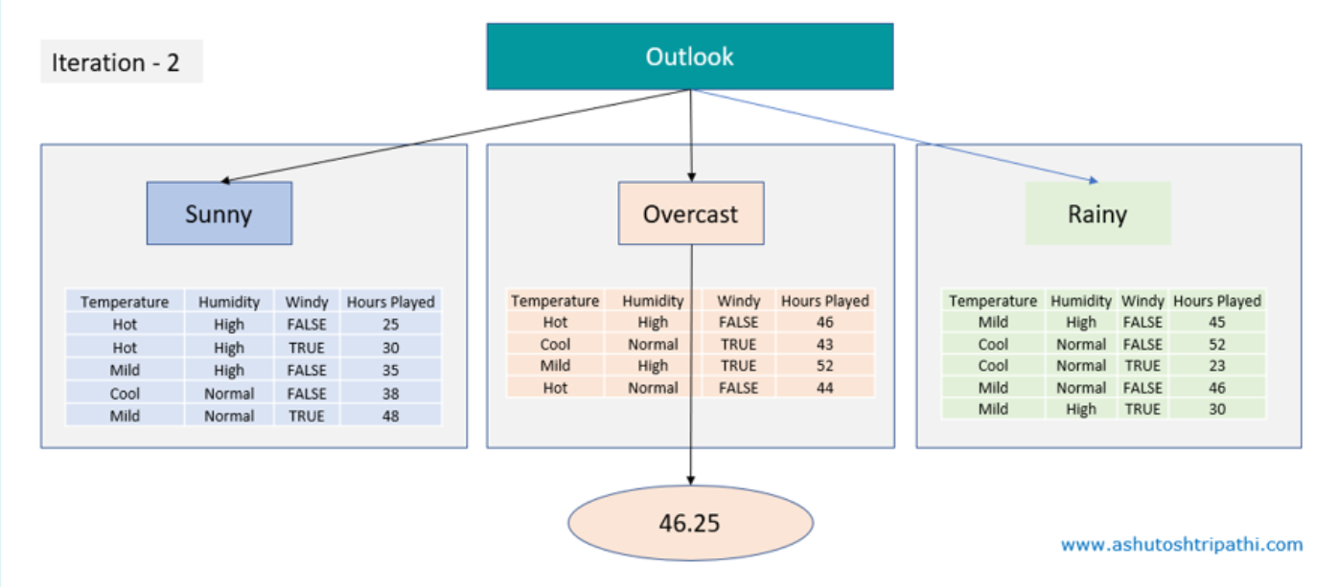

Slide 14
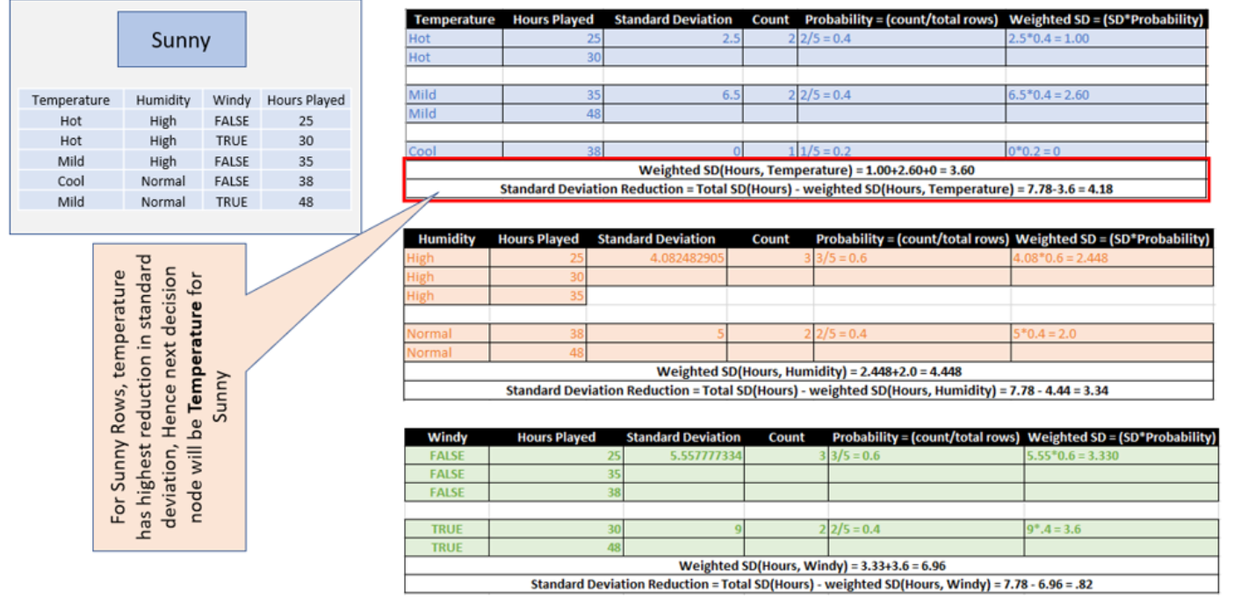
Step 4.c: Repeat the same SDR check for the remaining attributes.

Slide 15
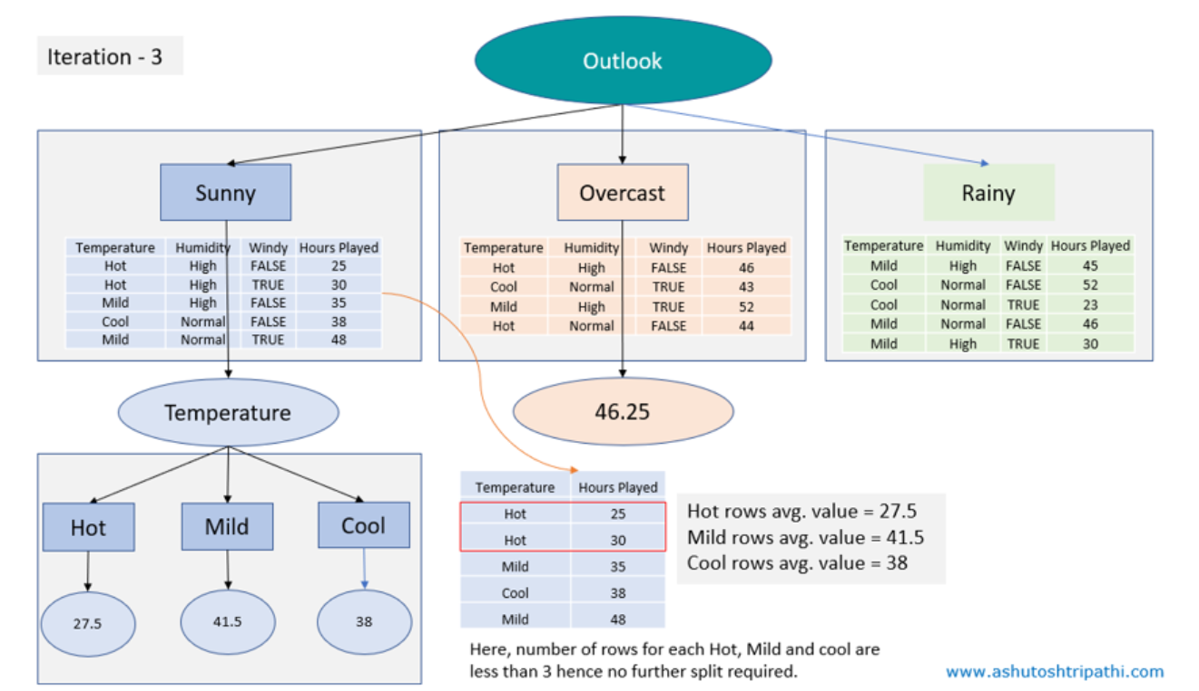

Slide 16
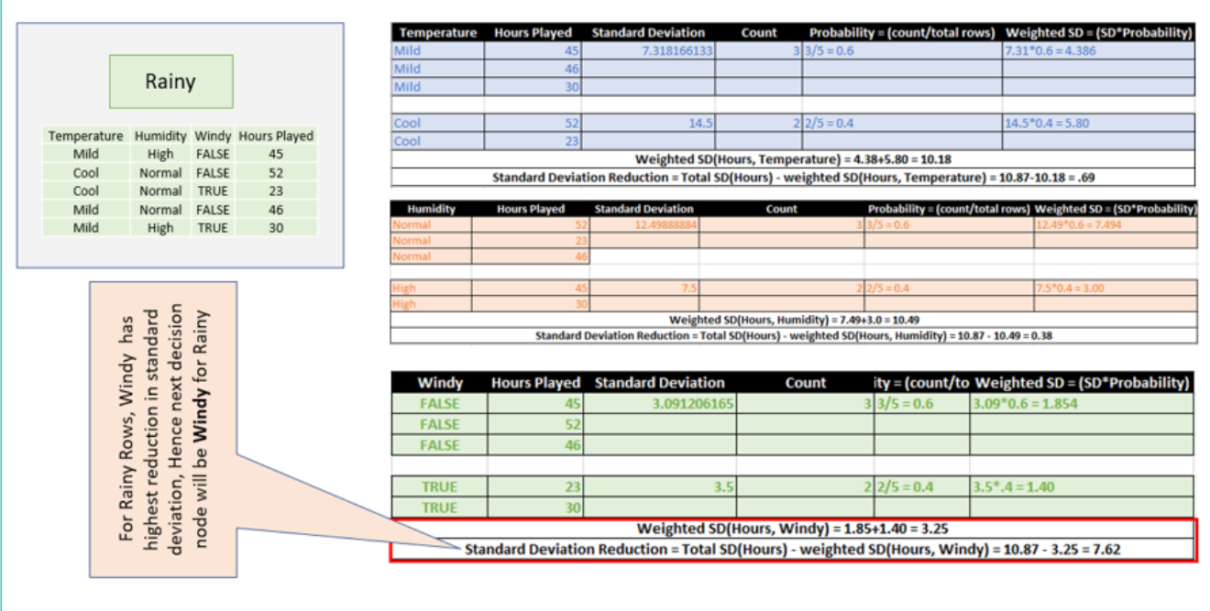

Slide 17
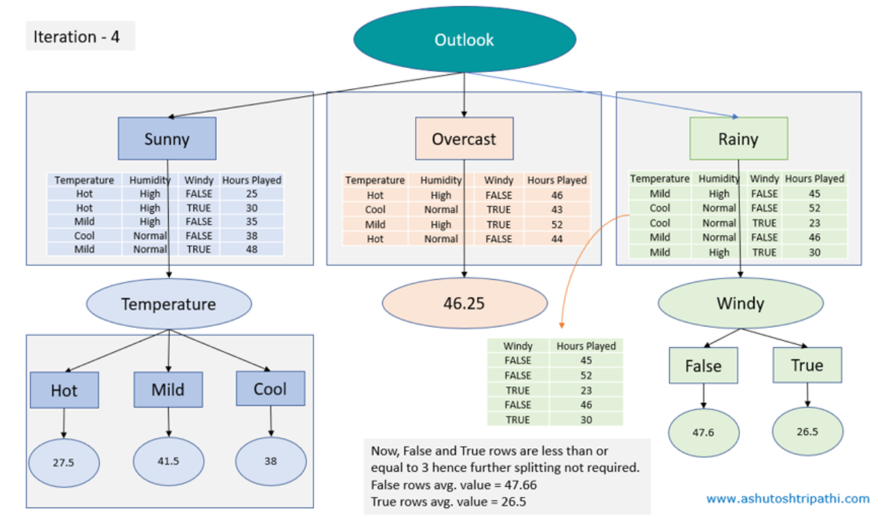

Slide 18
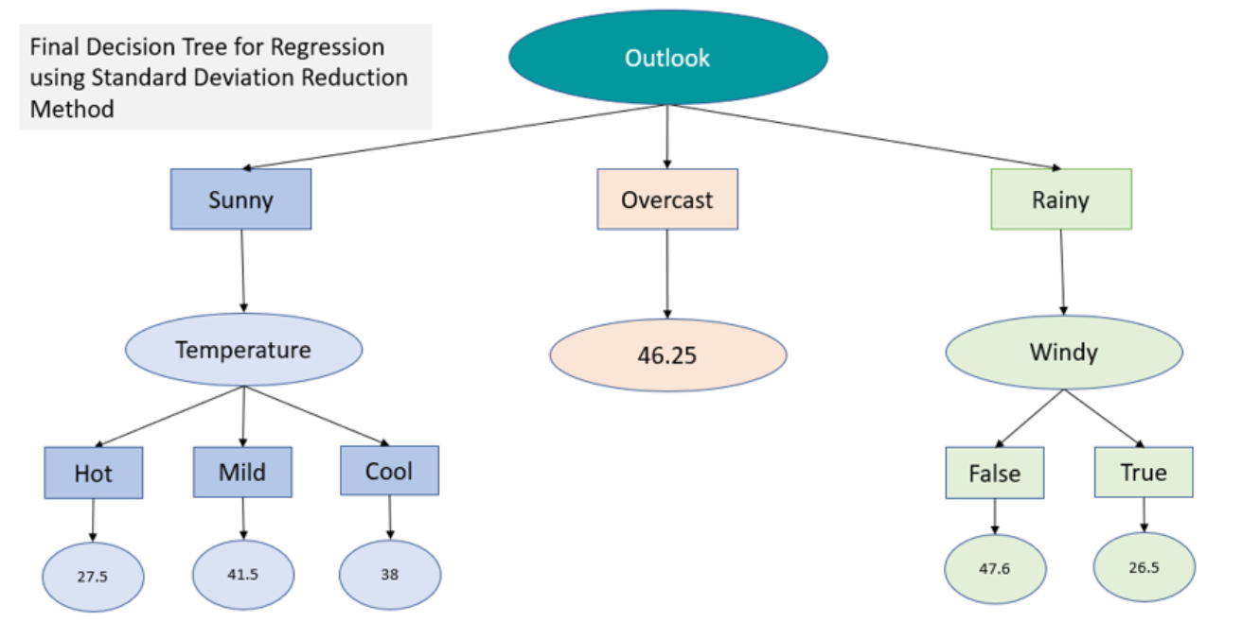

Slide 19
For continuous features
If features are continuous, internal nodes can test the value of a feature against a threshold.
We sort the numerical features in ascending order.
Set a thresholds and calculate SDR for each.
The threshold with highest SDR is taken.

Slide 20
THANK YOU!!

